Slide 1
EAPLI Framework

Slide 2
What it is
Standard application framework developed in the scope of the course unit “Engenharia de Aplicações” at Instituto Superior de Engenharia do Porto http://www.isep.ipp.pt

Slide 3
Components
Core
Domain driven design
Persistence
Utilities
Simple Console Presentation framework
Infrastructure Authz
Infrastructure Pub/Sub
Event publishing and dispatching

Slide 4
Dependencies
Java 8+
Apache Commons Logging
JPA
Spring Data JPA
Spring Framework dependency injection

Slide 5
pom.xml (eapli.framework)
<?xml version="1.0" encoding="UTF-8"?>
<project xmlns="http://maven.apache.org/POM/4.0.0" xmlns:xsi="http://www.w3.org/2001/XMLSchema-instance" xsi:schemaLocation="…">
<modelVersion>4.0.0</modelVersion>
<packaging>pom</packaging>
<version>9.1.1</version>
<name>eapli.framework</name>
<artifactId>eapli.framework</artifactId>
<version>1.3.0-SNAPSHOT</version>
<parent>...</parent>
<properties>...</properties>
<modules>
<module>eapli.framework.core</module>
<module>eapli.framework.infrastructure.authz</module>
<module>eapli.framework.infrastructure.pubsub</module>
</modules>
<dependencies>...</dependencies>
<build>...</build>
<distributionManagement>
<repository>
<id>bintray-pagsousa-eapli</id>
<name>pagsousa-eapli</name>
<url>https://api.bintray.com/maven/pagsousa/eapli/eapli.framework/;publish=1</url>
</repository>
</distributionManagement>
</project>

Slide 6
Building

Slide 7
Build
Maven
Dependency manager
Artifact (jar) repository
Build automation
other tasks:
deploy
run
…
Works for Eclipse, IntelliJ, Netbeans
Pom.xml

Slide 8
pom.xml (ecafeteria.base)
<?xml version="1.0" encoding="UTF-8"?>
<project xmlns="http://maven.apache.org/POM/4.0.0" xmlns:xsi="http://www.w3.org/2001/XMLSchema-instance" xsi:schemaLocation="…">
<modelVersion>4.0.0</modelVersion>
<groupId>eapli</groupId>
<artifactId>ecafeteria</artifactId>
<version>1.3.0-SNAPSHOT</version>
<packaging>pom</packaging>
<properties> … </properties>
<modules> … </modules>
<dependencies>
<dependency>
<groupId>eapli</groupId>
<artifactId>eapli.framework.core</artifactId>
<version>9.1.1</version>
</dependency>
<dependency>
<groupId>eapli</groupId>
<artifactId>eapli.framework.infrastructure.authz</artifactId>
<version>9.1.1</version>
</dependency>
<dependency>
<groupId>eapli</groupId>
<artifactId>eapli.framework.infrastructure.pubsub</artifactId>
<version>9.1.1</version>
</dependency>
<dependency> … </dependency>
<dependency> … </dependency>
</dependencies>
<repositories>
<repository>
<snapshots>
<enabled>false</enabled>
</snapshots>
<id>bintray-pagsousa-eapli</id>
<url>http://dl.bintray.com/pagsousa/eapli</url>
</repository>
</repositories>
</project>

Slide 9
Domain Driven Design

Slide 10
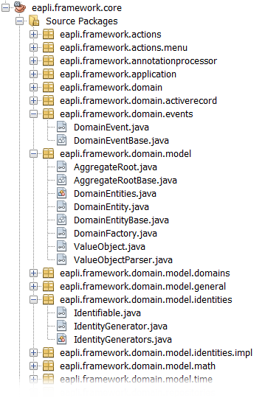
Domain Driven Design
DDD pattern interfaces
ValueObject
DomainEntity
AggregateRoot

Slide 11
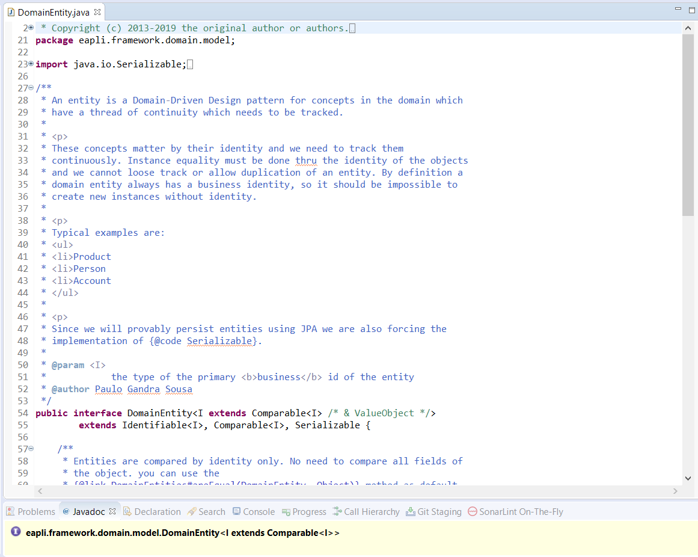
DomainEntity.java

Slide 12
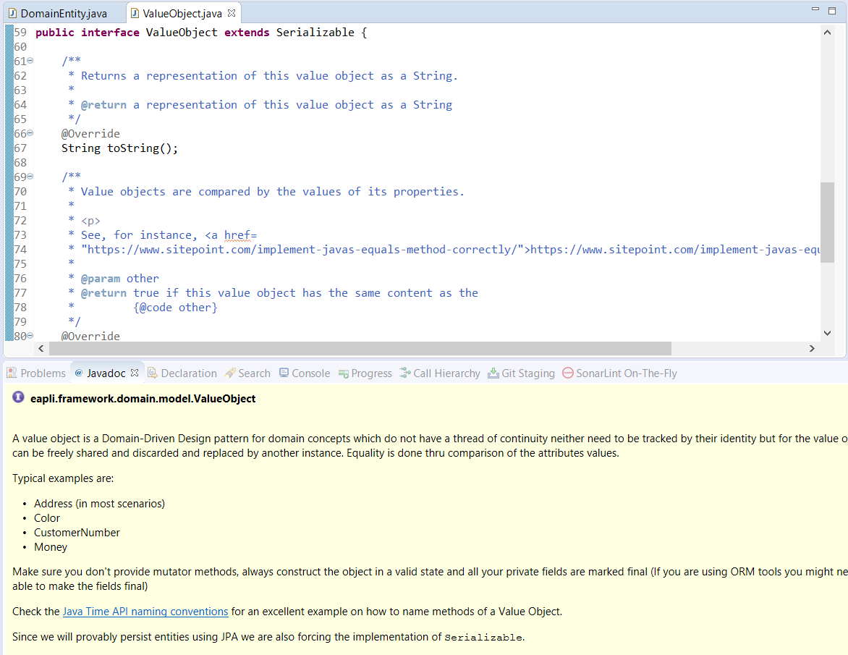
ValueObject.java

Slide 13
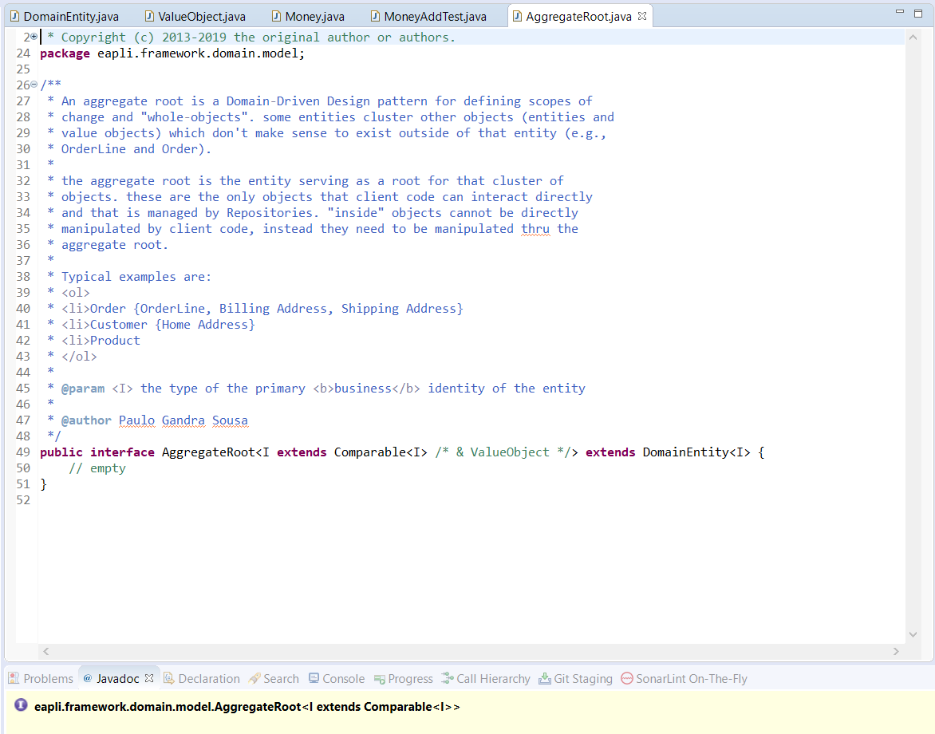
AggregateRoot.java

Slide 14
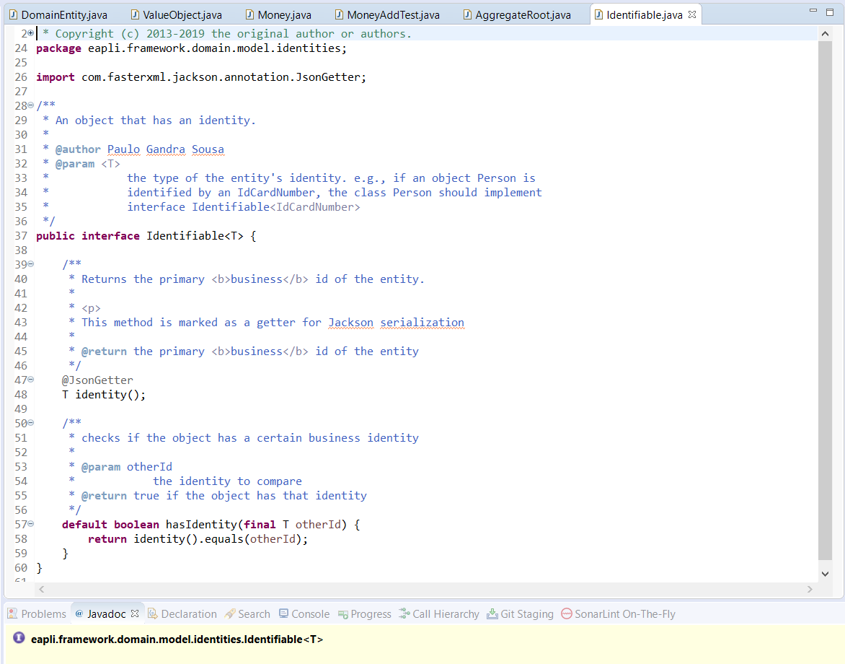
Identifiable.java

Slide 15
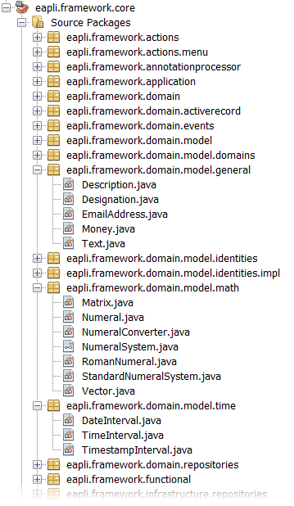
Domain Driven Design
Domain objects
Money
Range
Time period
…

Slide 16
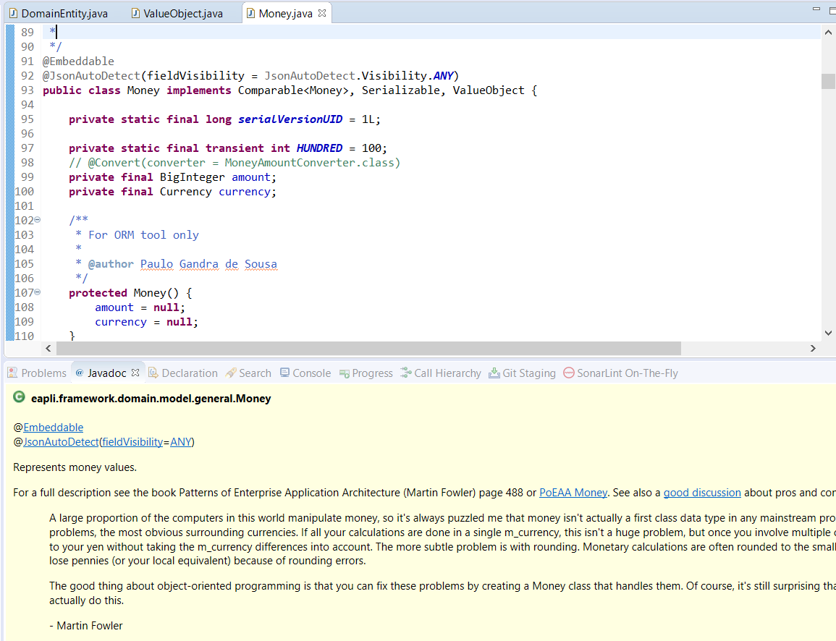
Money.java

Slide 17
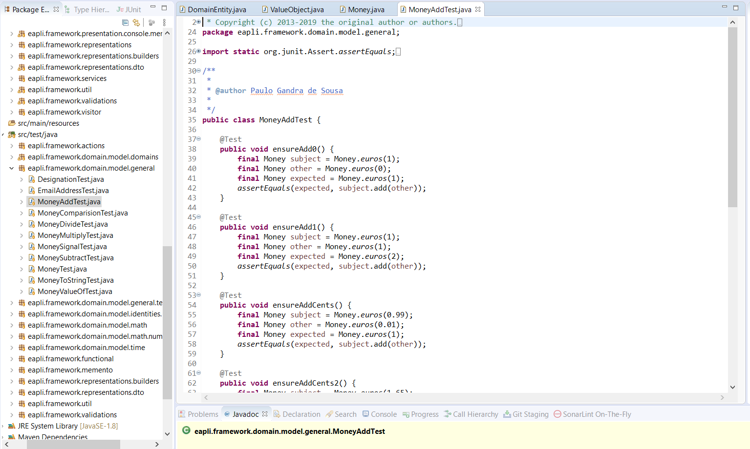
MoneyAddTest.java

Slide 18
Persistence

Slide 19
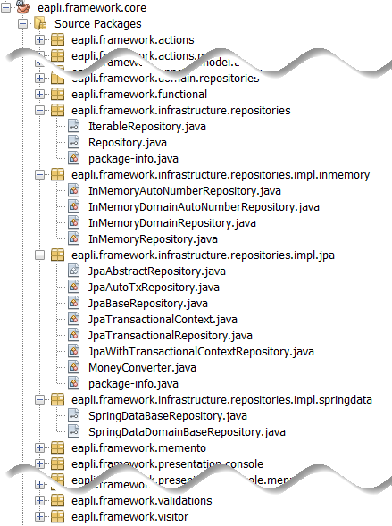
Persistence
Persistence
Repository interfaces
Implementations
JPA
InMemory
Spring Data JPA
For EAPLI, spring and spring data are out of scope
Notes:
3 packages principais
Model – classes utilitárias que podem ser usadas em qq modelo, ex., «value object» Money
Patterns – essencialmente interfaces para “marcação” de classes DDD. Possui subpackage com implementações auxiliares
Persistence.jpa – classe utilitária JpaRepository

Slide 20
Repositories
Repository
TransactionalContext
Interfaces for describing repository functionalities and transactions

Slide 21
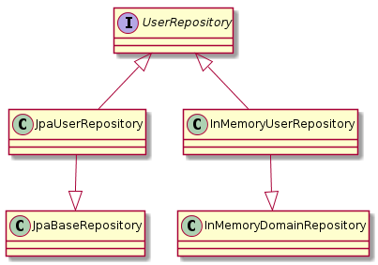
Example: User Repository

Slide 22
Example: User Repository
public interface UserRepository extends Repository<SystemUser,Username> {
Iterable<SystemUser> findByActive(boolean active);
}
public class InMemoryUserRepository
extends InMemoryDomainRepository<SystemUser,Username>
implements UserRepository{
@Override
public Iterable<SystemUser> findByActive(final boolean active) {
return match(e -> e.isActive() == active);
}
}
public class JpaUserRepository
extends JpaBaseRepository<SystemUser,Username>
implements UserRepository{
@Override
public Iterable<SystemUser> findByActive(final boolean active) {
return match(UserRepositoryConstants.FIND_BY_ACTIVE, "active", active);
}
}
22

Slide 23
Example
public interface MaterialRepository extends Repository<Material, Long> {
Material findByAcronym(string acronym);
}
public class InMemoryMaterialRepository extends InMemoryRepositoryWithLongPK<Material>
implements MaterialRepository{
@Override
public Material findByAcronym(string acronym){
return matchOne(e -> e.id().equals(acronym));
}
}
public class JpaMaterialRepository extends CafeteriaJpaRepositoryBase<Material, Long>
implements MaterialRepository{
@Override
public Material findByAcronym(string acronym){
return matchOne("e.acronym=:acronym", "acronym", acronym);
}
}

Slide 24
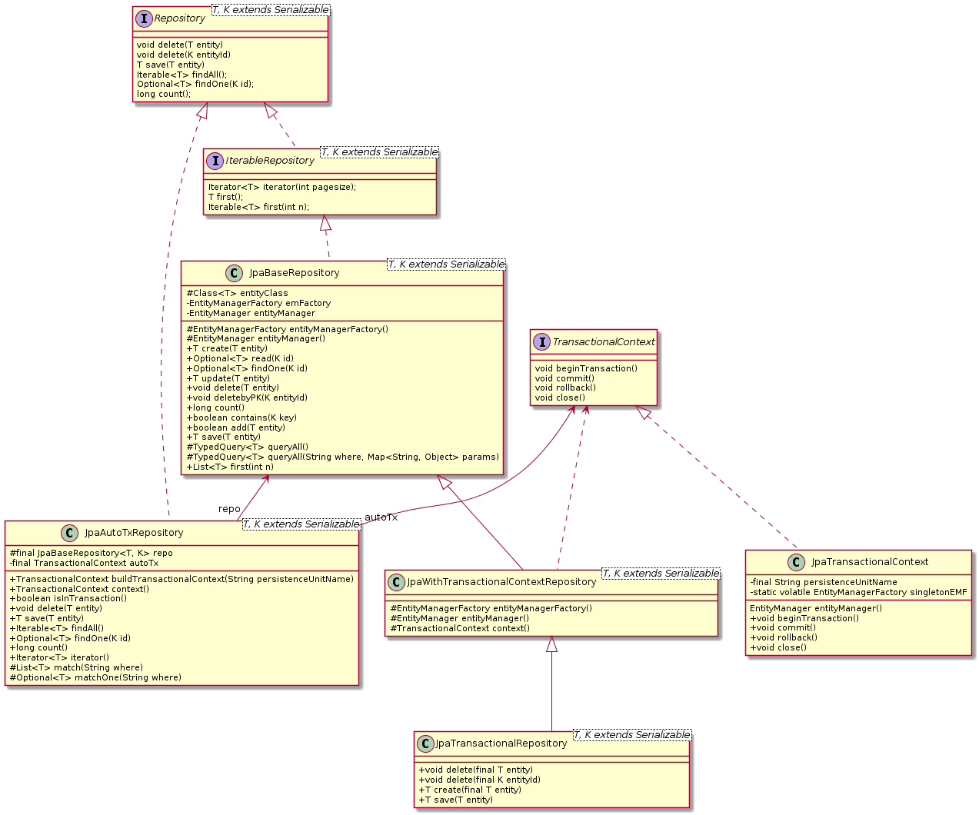
24

Slide 25
Persistence
Controller needs to access the repositories
But we have three repository implementations
In memory
Relational database thru JPA
Relational database thru SpringData
Hide persistence details from rest of the code
Interfaces
Dependency injection or Factories
Notes:
Necessidade de suportar duas persistências
Em memória
BD usando ORM JPA
Esconder este pormenor do restante código
Vários repositórios (um por agregado)
Fábrica para os repositórios de acordo com tipo de persistência
Fábrica de fábricas para esconder lógica de criação de qual o tipo de persistência a usar
Abstract Factory Pattern

Slide 26
Notes:
Each repository is defined by an interface that is the well known contract to the rest of the application. We will have one repository per domain aggregate.
Since we have interfaces we need a factory to hide the details of the concrete object to create. E.g., ExpenseTypeRepositoryFactory
Since we have several repositories we group their creation in a single factory (i.e., RepositoryFactory) to avoid duplication of code, i.e., each factory would have the decision code to choose which implementation to create. This way the JpaFactory knows it only creates Jpa implementations

Slide 27
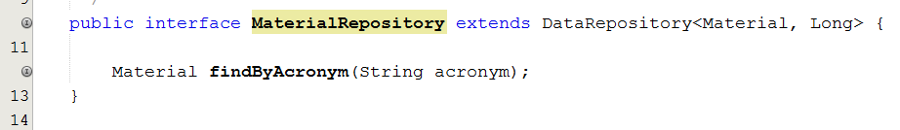
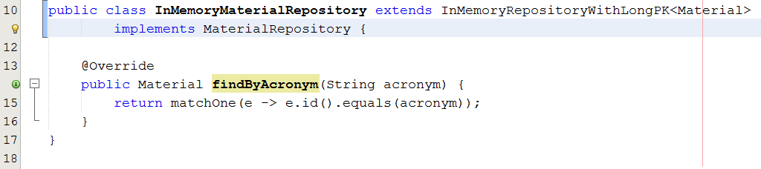
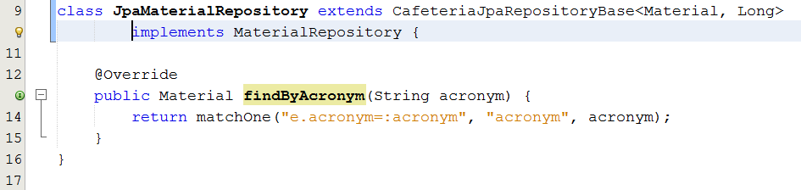
Example

Slide 28
In memory Repositories
InMemoryBaseRepository
InMemoryBaseRepositoryWithAutoNumber
For pedagogical testing purposes only!

Slide 29
JPA Repositories
JpaBaseRepository
Generic repository implementation that expects the entity manager factory to be injected by a container, e.g., web server
JpaNotRunningInContainerBaseRepository
For scenarios where the code is not running in a container but transaction is managed by the outside, e.g., controller
JpaTransactionalBaseRepository
For scenarios not running in a container but transactions are created and committed by each repository method; the connection is also closed automatically in each method.
JpaAutoTxRepository
Dual behaviour to either have outside transactional control or explicit transaction in each method

Slide 30
Spring Data JPA repositories

Slide 31
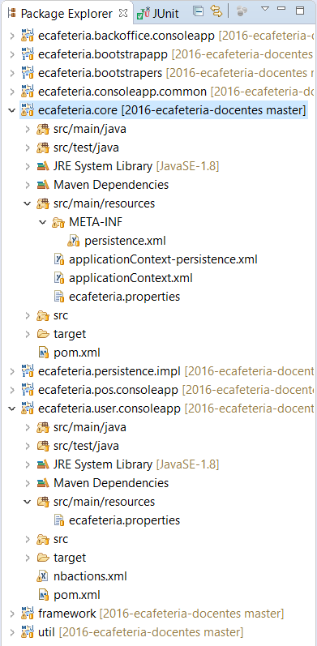
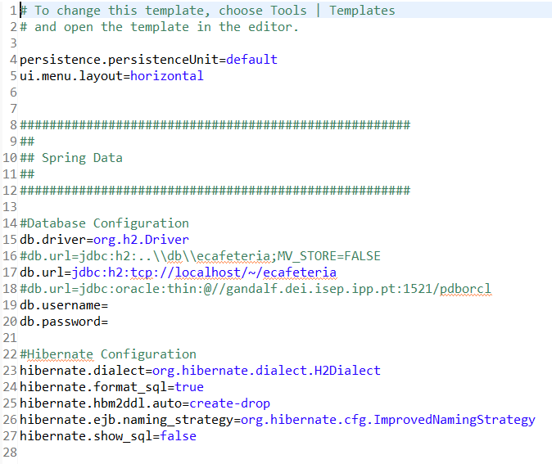
Resources

Slide 32
applicationContext.xml

Slide 33
applicationContext-persistence.xml

Slide 34
Transaction control
Preferably use a container and managed transaction context, e.g., spring
Optionally control the transaction yourself

Slide 35
Transaction control #1
Managed repositories, e.g., Spring Framework
Spring will load the repositories
Spring will control the transactional context

Slide 36
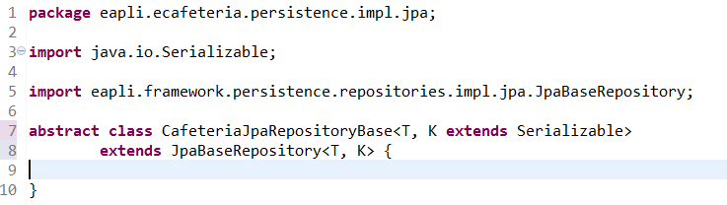
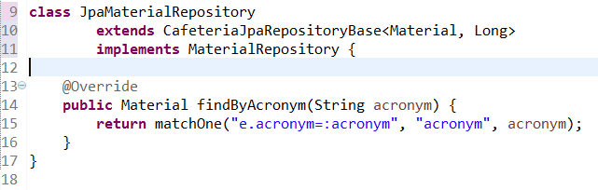
All JPA repositories extend JpaBaseRepository to use spring transactional control

Slide 37
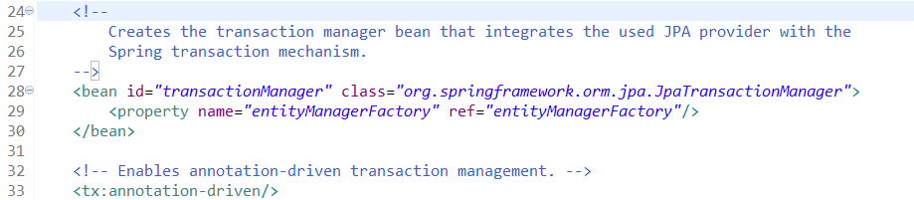
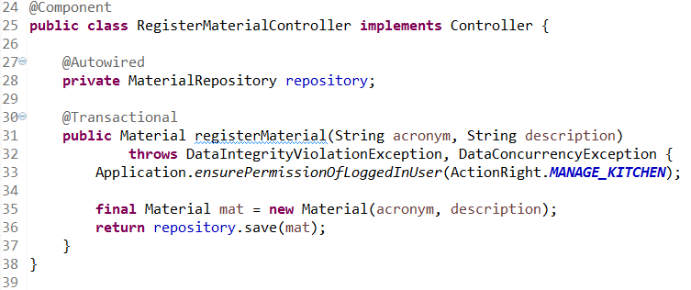
Spring Transactional control

Slide 38
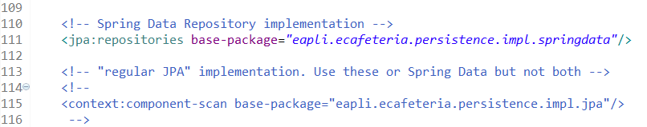
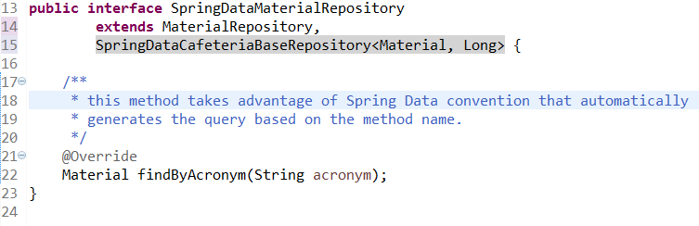
SpringData repositories (1)

Slide 39
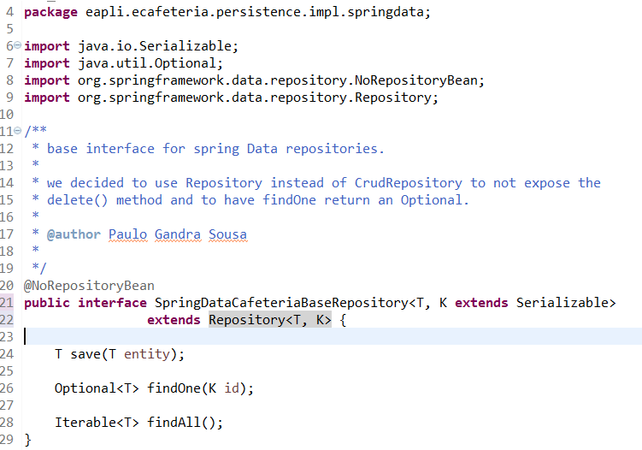
SpringData repositories (2)

Slide 40
Transaction control #2
Control the transaction yourself using helper classes in the persistence package

Slide 41
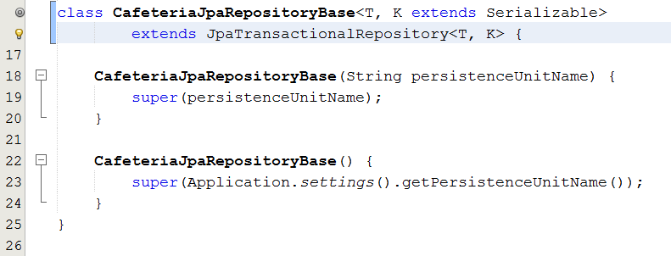
Full transaction control by the repository

Slide 42
Transaction control outside of the repository (1)
Accepting a signup request needs to
Create a system user
Create a cafeteria user
Change the status of the signup request
Three different aggregates!

Slide 43
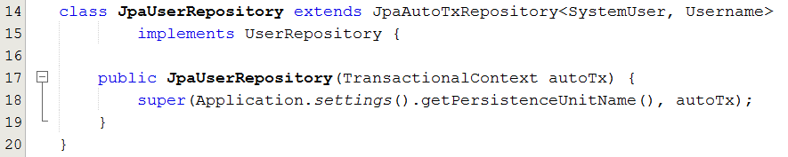
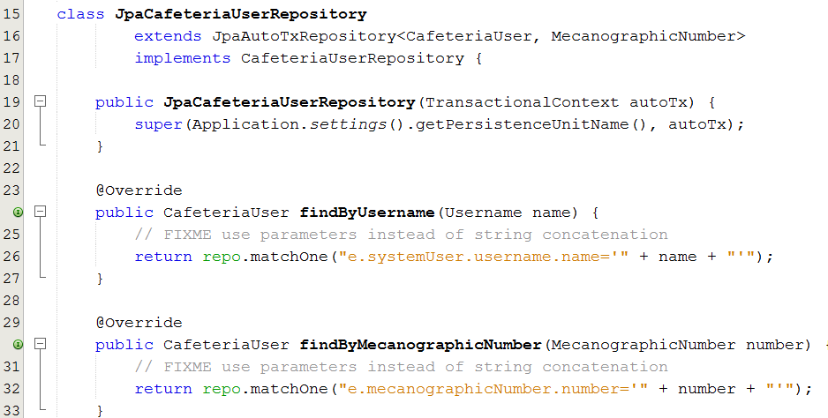
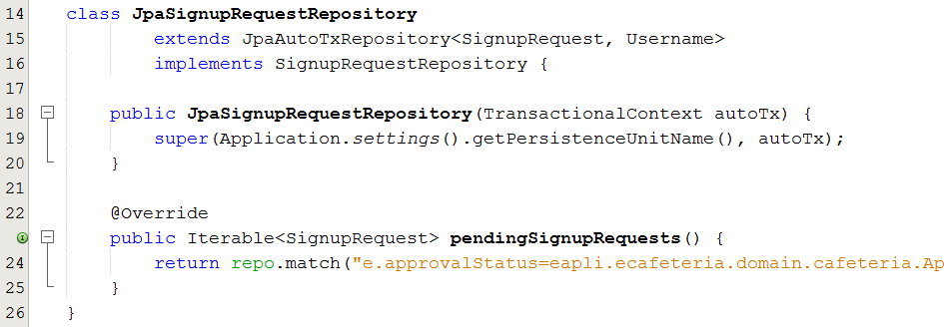
Transaction control (2): use JpaAutoTxRepository

Slide 44
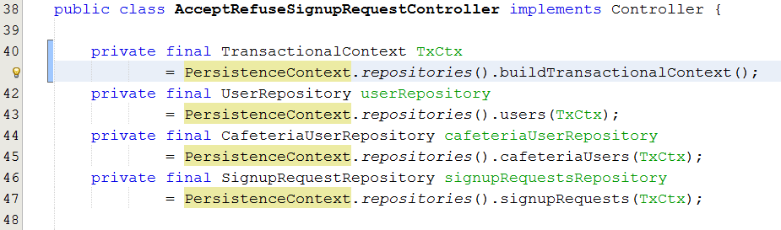
Transaction control (3): explicit control by the controller

Slide 45
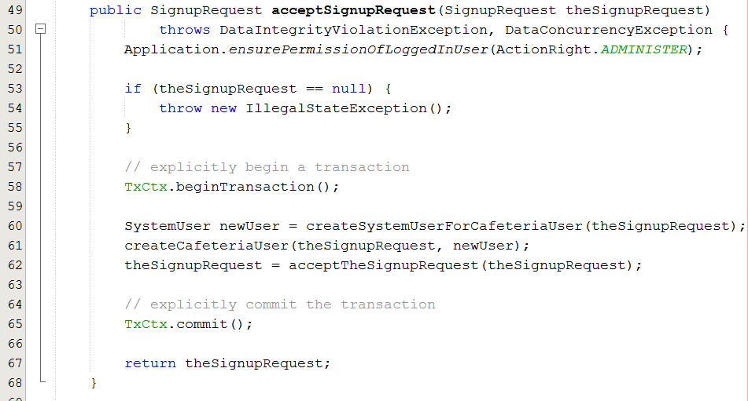
Transaction control (3): explicit control by the controller

Slide 46
Other parts of the core framework

Slide 47
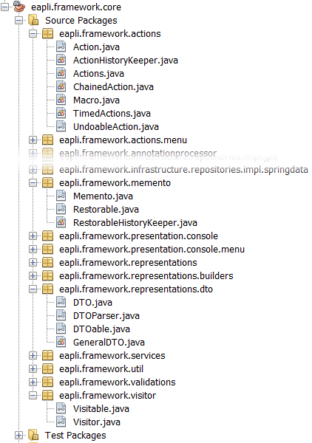
Common patterns
Actions
a.k.a Command
Memento
Visitor
DTO

Slide 48
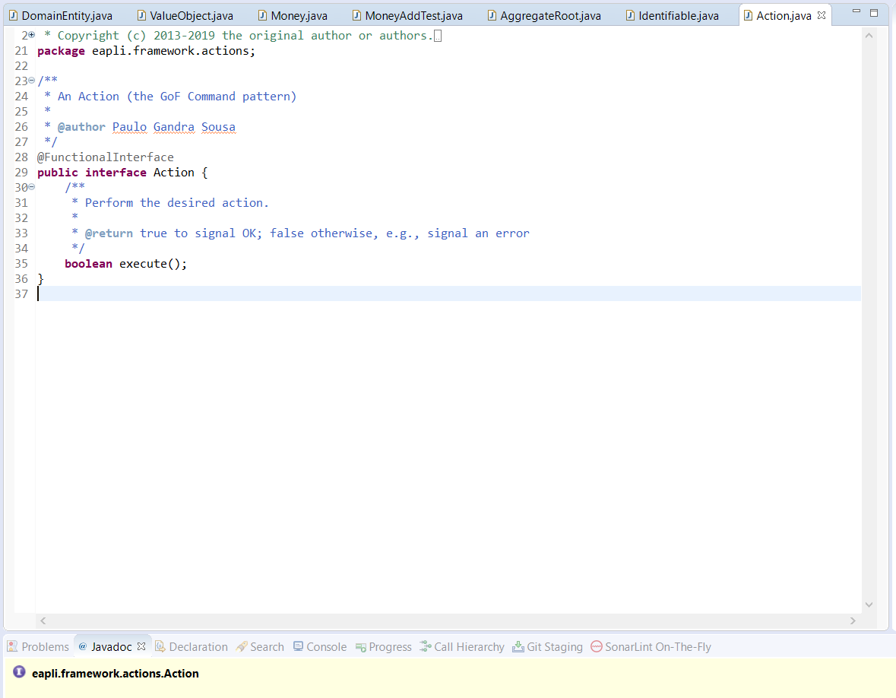
Action.java

Slide 49
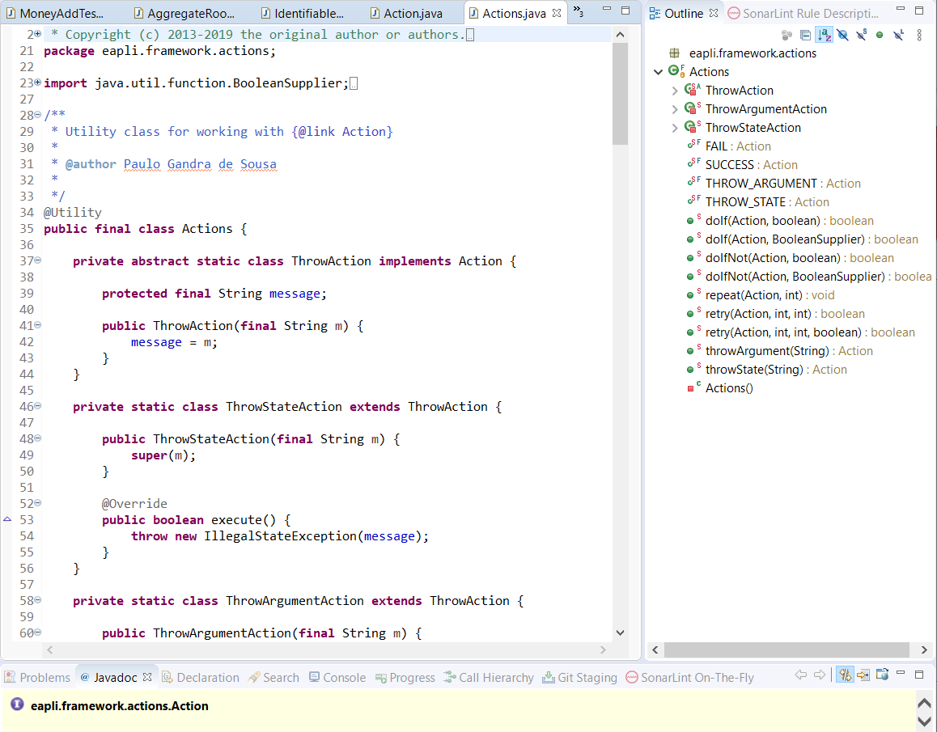
Actions.java

Slide 50
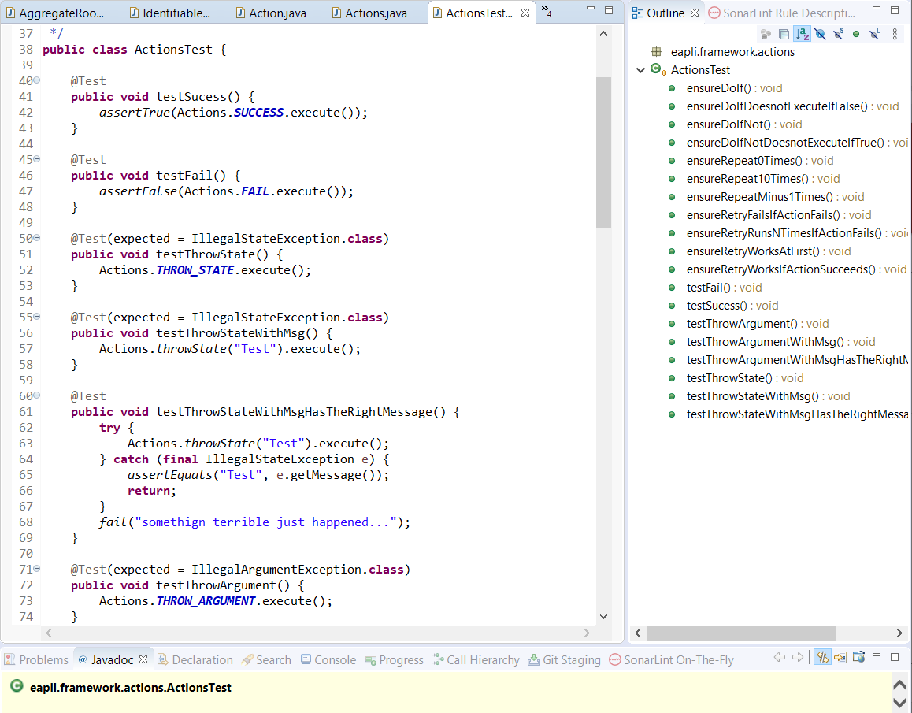
ActionTest.java

Slide 51
Utilities
Console
Helper console reading functions
DateTime
Simplifies manipulation of dates and times through java Calendar
Files
File manipulation helper
Arrays
Collections
Comparables

Slide 52
Utilities
HashCoder
Simplifies generation of a hash code class
Helper console reading functions
NumberGenerator
Simple API for Java Random class
Strings
String manipulation
StringMixin
Math
Sample math utility

Slide 53
Utilities
StringPredicates
Predicates to test strings
NumberPredicates
Predicates to test primitive numbers
PreConditions
Validates preconditions on methods, usually the method’s parameters
Throws InvalidArgumentException
Invariants
Validates internal consistency of an object
Throws InvalidStateException

Slide 54
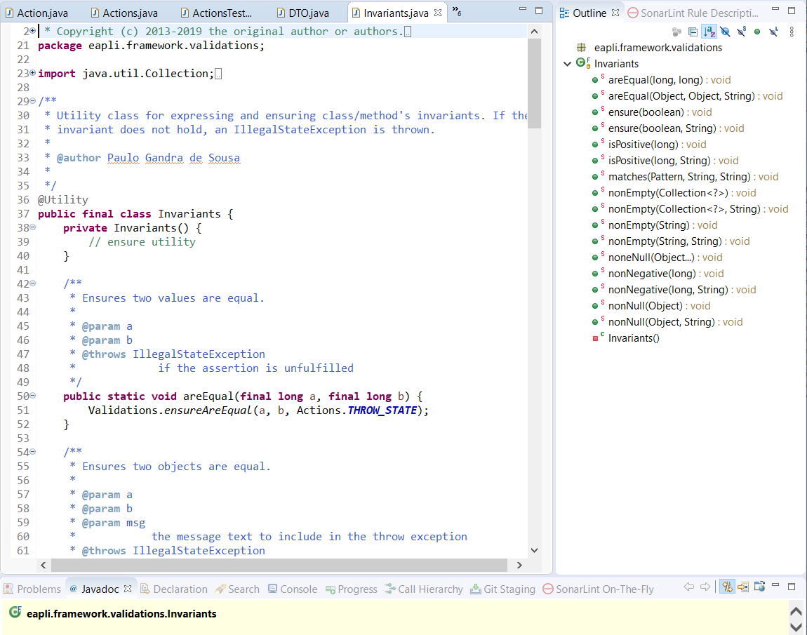
Invariants.java

Slide 55
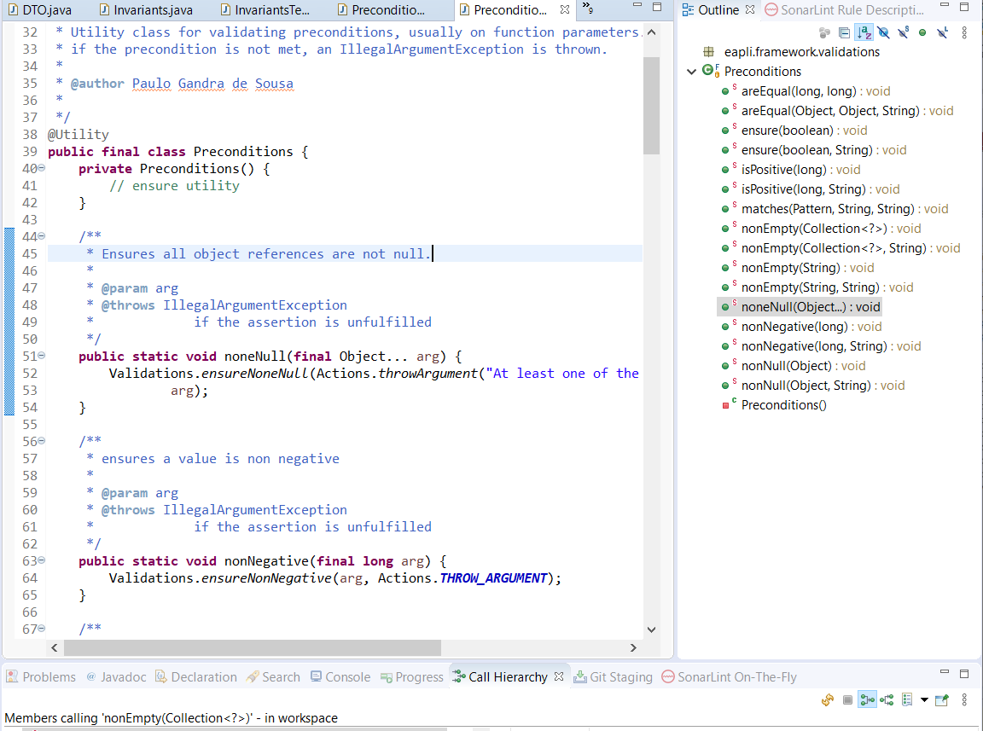
Preconditions.java

Slide 56
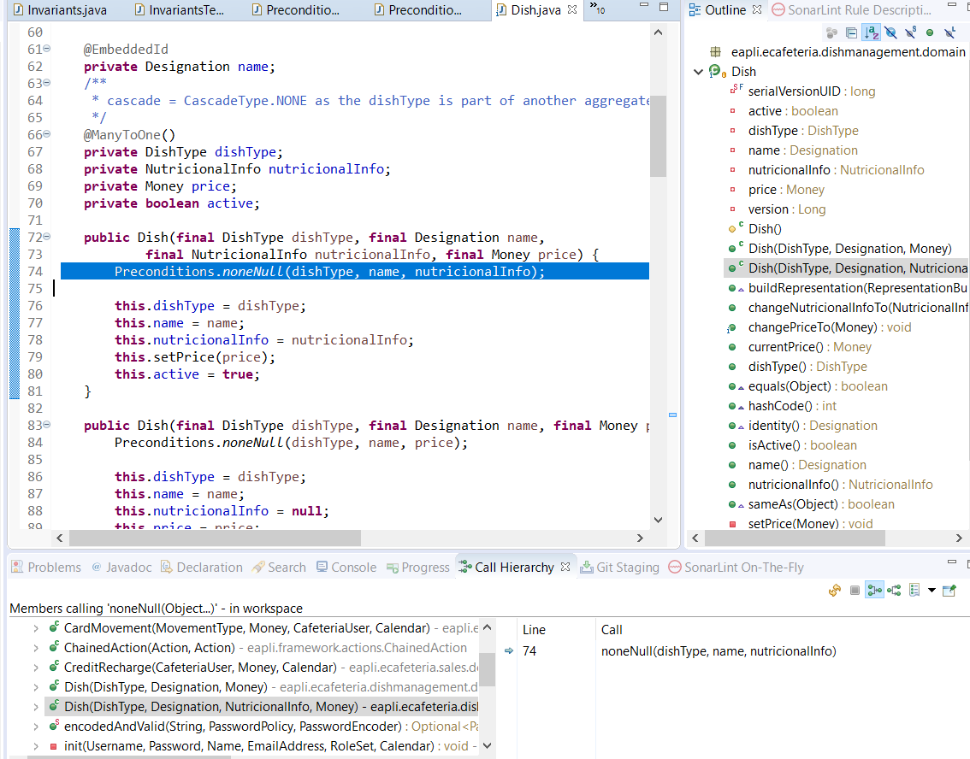
Example

Slide 57
Console Presentation layer

Slide 58
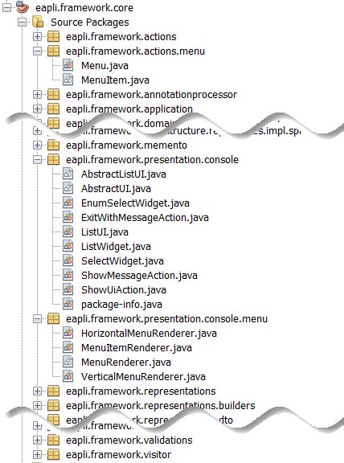
Presentation

Slide 59
Presentation

Slide 60
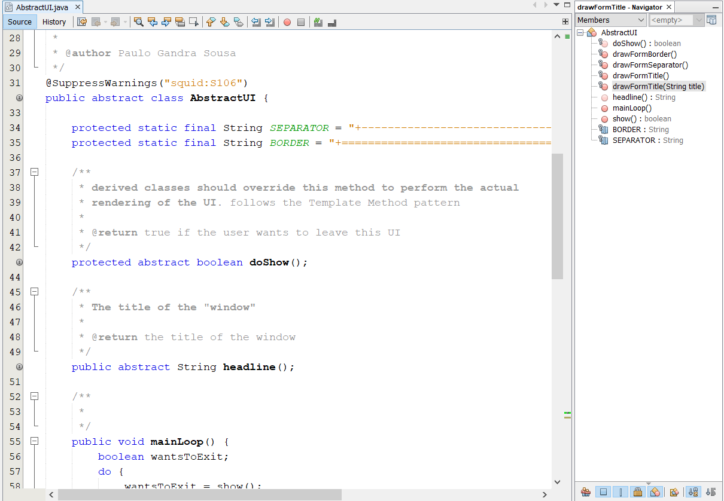
AbstractUI.java

Slide 61
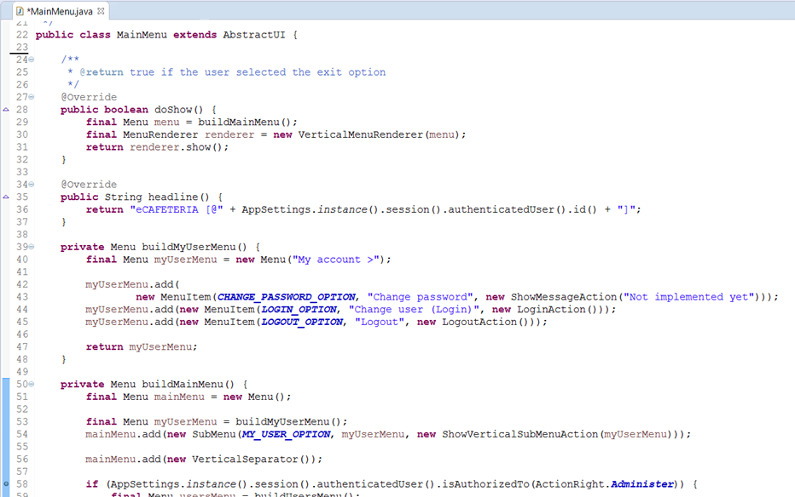
Example

Slide 62
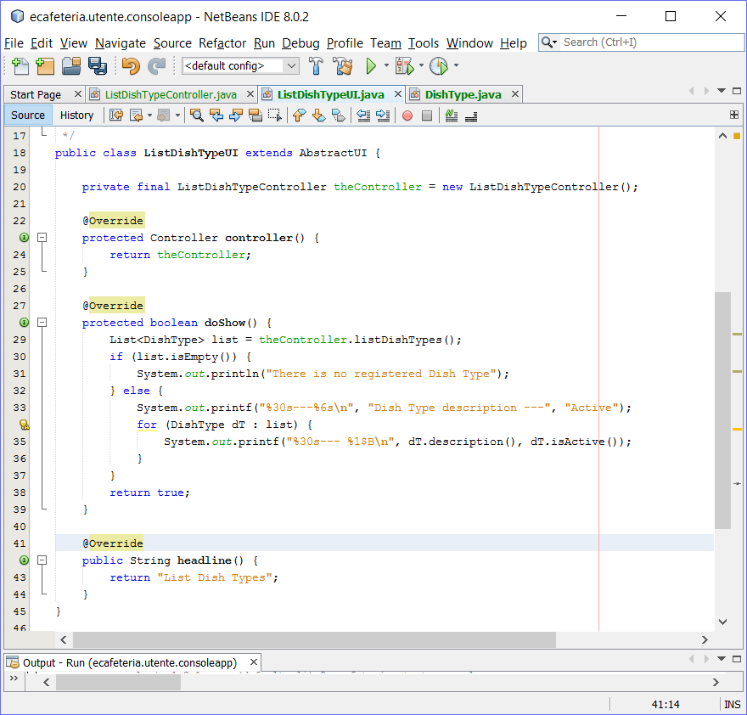
Example

Slide 63
Infrastructure AUTHZ

Slide 64
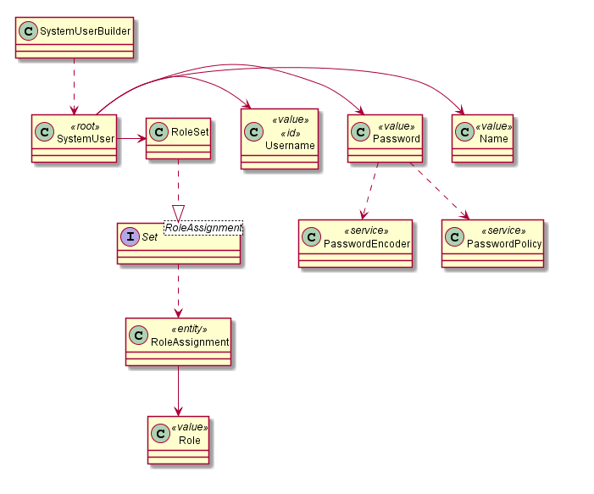
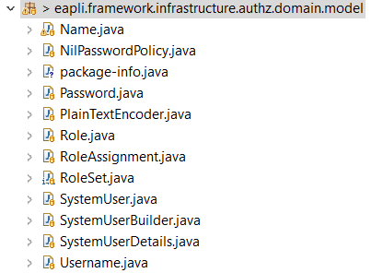
User model

Slide 65
Domain invariants
@Test
public void ensurePasswordHasAtLeastOneDigitAnd6CharactersLong() {
new Password("abcdefgh1");
}
@Test(expected = IllegalArgumentException.class)
public void ensurePasswordsSmallerThan6CharactersAreNotAllowed() {
new Password("ab1c");
}
@Test(expected = IllegalArgumentException.class)
public void ensurePasswordsWithoutDigitsAreNotAllowed() {
new Password("abcdefgh");
}

Slide 66
Domain
public class Password {
(…)
public Password(String password) {
if (!meetsMinimumRequirements(password)) {
throw new IllegalStateException();
}
thePassword = password;
}
private boolean meetsMinimumRequirements(String password) {
if (Strings.isNullOrEmpty(password) || password.length() < 6 ||
!Strings.containsDigit(password)) {
return false;
}
return true;
}
Notes:
Extrato faltam aqui alguns métodos. Devem ver o código fonte completo

Slide 67
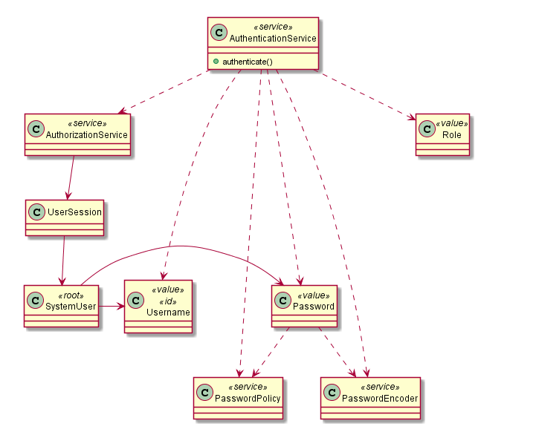
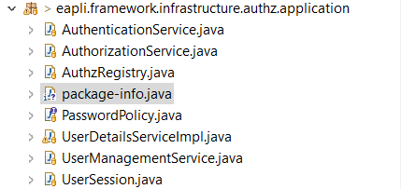
Using the Authz component

Slide 68
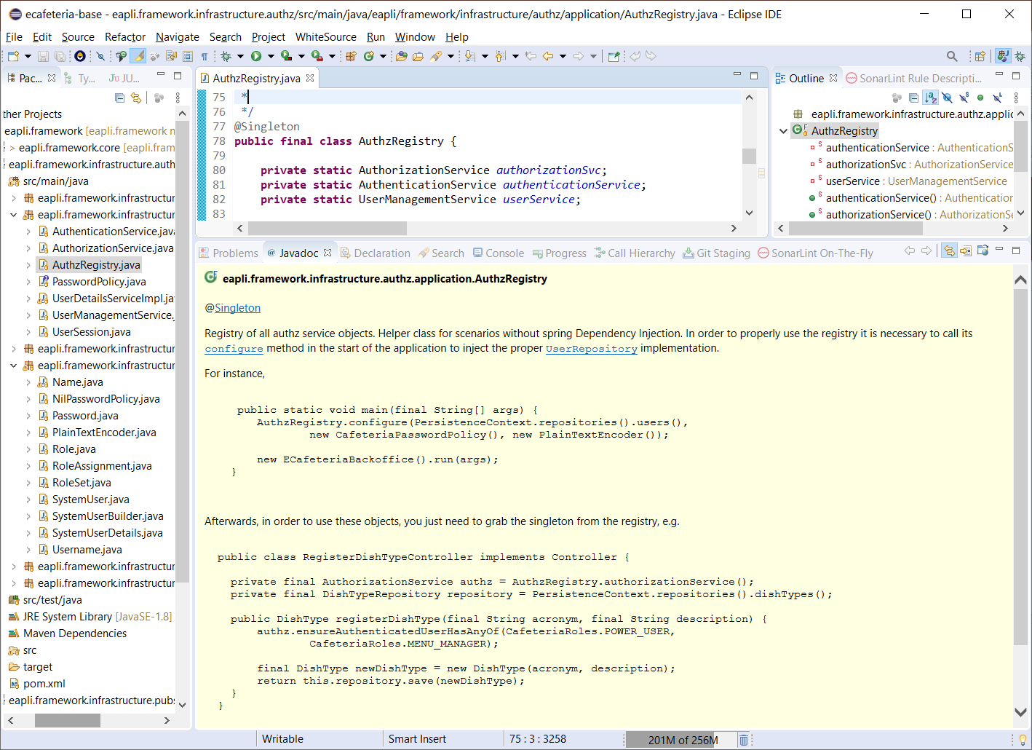
Using the authz framework

Slide 69
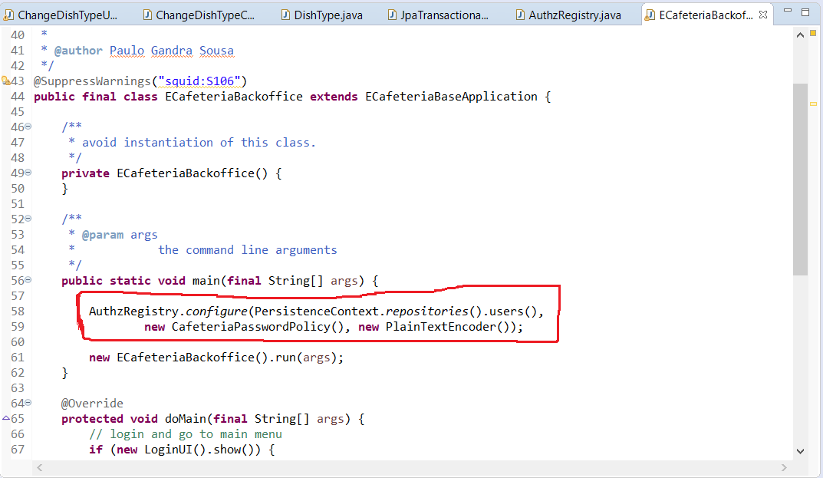
Main method

Slide 70
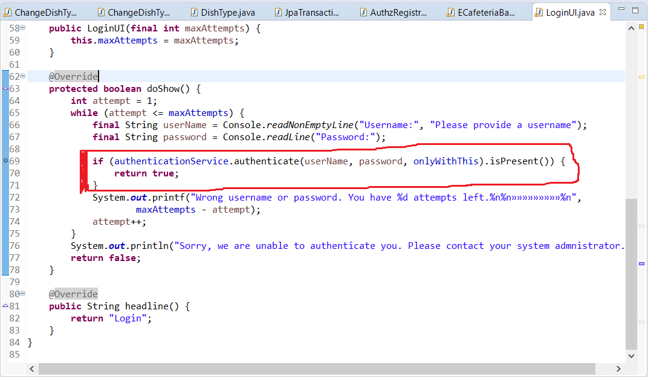
Perform authentication

Slide 71
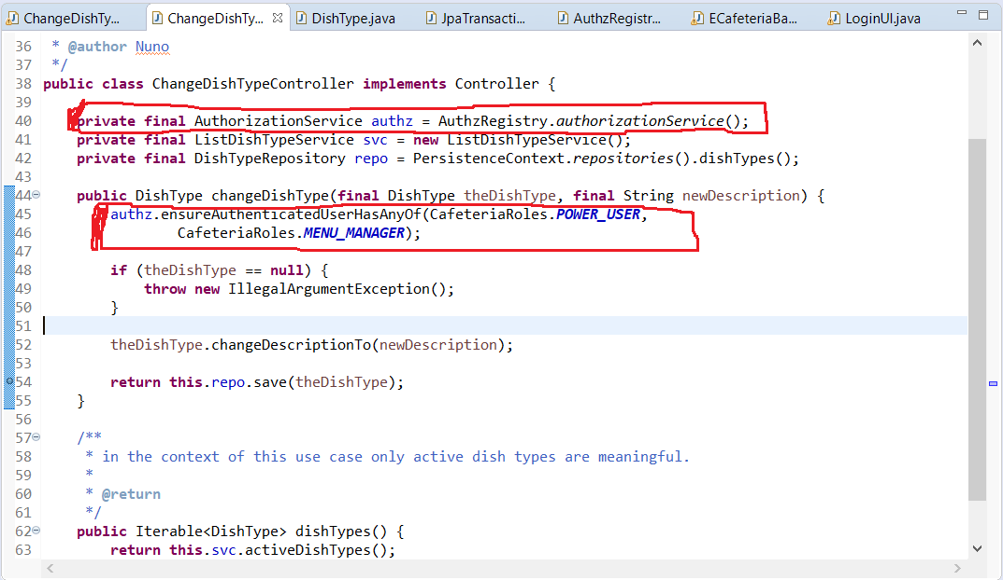
Authorization in each controller

Slide 72
Infrastructure Pub/Sub

Slide 73
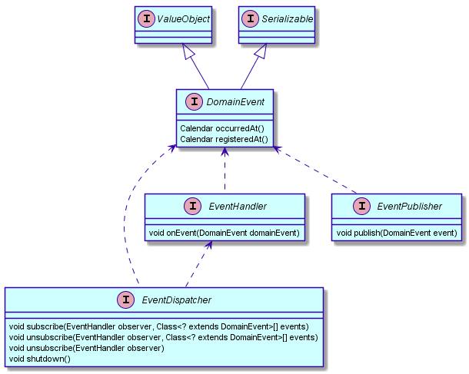
Abstract service

Slide 74
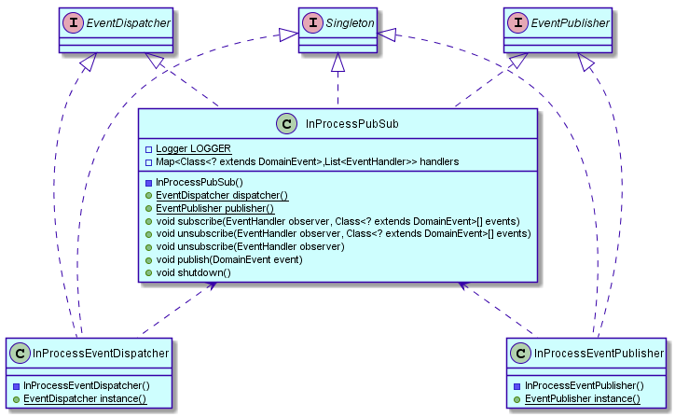
In Process

Slide 75
In Process
Client code uses InProcessEventPublisher or InProcessEventDispatcher via static instance() method or via dependency injection

Slide 76

Simple Persistent

Slide 77
Simple Persistent
Use only via dependency injection
Domain entities must be registered in persistence.xml

Slide 78

Using the Pub/Sub component

Slide 79


Slide 80


Slide 81


